Slide 1


Project Presentation of CO-OP Project at Industry (Module-2) (22CS421)
On
Automated Copy Generation & Sentiment Analysis Using Transformer Models
Abhay Chauhan · Aditya Singh Solanki
Dhruv Walia · Parth Goyal
BE-CSE, Roll Numbers: 2210991142, 2210991201, 2210990280, 2210992028
Supervised By: Dr. Preeti Saini
Department of Computer Science and Engineering, Chitkara University, Punjab
Industry CO-OP Module-2March 2026

Slide 2

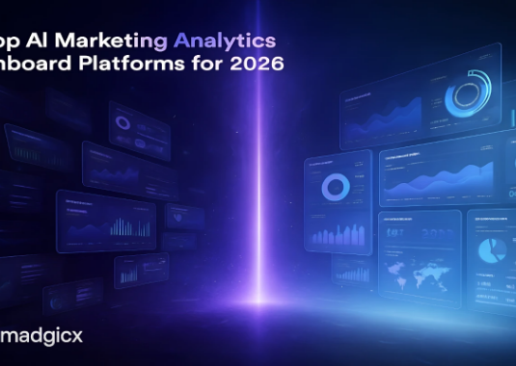
Introduction
This project addresses the growing demand for high-volume, high-quality creative assets in the Performance Marketing industry.
•
Modern ad platforms require constant Creative Refresh to maintain ROI.
•
Manual copywriting is a bottleneck that drives up Customer Acquisition Costs (CAC).
•
Our solution leverages Generative AI (GPT-2) and Sentiment Analysis (DistilBERT) to automate this pipeline.
IntroductionSlide 2

Slide 3
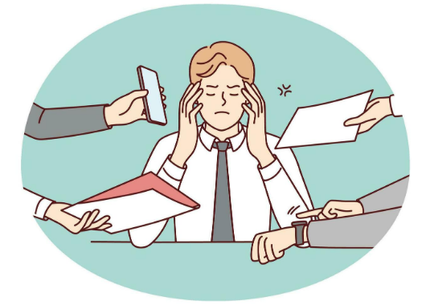
Executive Summary
Core Project Goals
To reduce creative fatigue by automating the production of high-conversion ad copy with robust sentiment safeguards.
•
Automation: Replace manual drafting with LLM pipelines.
•
Efficiency: Reduce cycle time by 40%.
•
Brand Safety: 100% brand-positive alignment via filtering.
Executive SummarySlide 3

Slide 4


System Architecture: End-to-End Pipeline
1. Generation
2. Validation
3. Deployment
GPT-2 fine-tuned on 300k industry-standard headlines.
DistilBERT filtering candidates based on sentiment (>0.85).
Direct sync of approved copy to live A/B test environments.
ArchitectureSlide 4

Slide 5
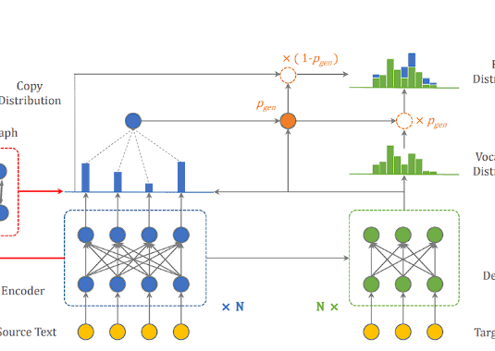
Generative Layer: GPT-2 Mechanism
The system utilizes Masked Self-Attention to ensure contextual coherence.
•
Context Span: Maintaining brand tone across the entire ad body.
•
Sampling: Nucleus sampling (p=0.9) balances diversity and sense.
•
Fine-tuning: Specialized on ad headlines to learn marketing persuasive patterns.
GPT-2 LayerSlide 5

Slide 6

Mathematical Foundation: Attention Mechanism
The Scaled Dot-Product Attention allows the model to weigh the importance of different words in a marketing prompt to generate high-relevance outputs.
MathematicsSlide 6

Slide 7

Safeguarding Brand Voice
0.85 Sentiment Threshold
Every candidate passes through DistilBERT for full-context emotion scoring.
•
0% False-Positive Rate: Eliminating negative brand alignment.
•
Hallucination Filtering: Intercepts sarcasm and off-brand phrasing.
•
Prioritizes precision over recall for production stability.
Safety GateSlide 7

Slide 8
Training Environment & Hyperparameters
Specification | GPT-2 (Generation) | DistilBERT (Sentiment)
Training Set | 300,000 Ad Headlines | 500,000 Product Reviews
Hardware | NVIDIA A100 GPU | Cloud FP16 Training
Optimizer | AdamW · LR 5e-5 | AdamW · LR 2e-5
Epochs | 4 Epochs | 3 Epochs
Model ConfigurationSlide 8

Slide 9

Results: Training Convergence
Domain Adaptation
Sentiment Accuracy
Validation perplexity dropped significantly during training:
•
DistilBERT Accuracy: 94.8%
•
Zero-Shot: 45.2 Perplexity
•
Full BERT Accuracy: 95.3%
•
Epoch 4: 18.4 Perplexity
•
SVM Baseline: 89.5%
•
Improvement: 59% gain in language specialization.
DistilBERT retains 97% of BERT's performance with much higher speed.
Results ISlide 9

Slide 10
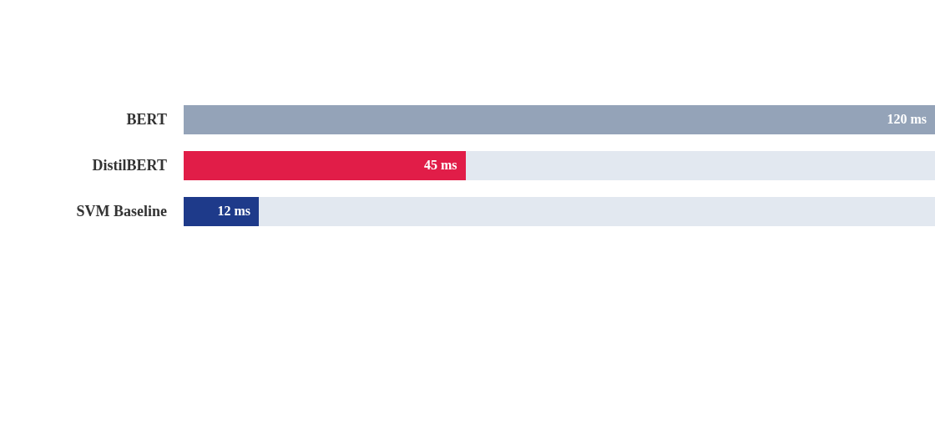

Results: Inference Speed at Scale
Conclusion: 62.5% Latency Reduction achieved. Sub-50ms latency makes this pipeline viable for high-throughput, real-time creative generation.
Results IISlide 10

Slide 11

Conclusion & Path Forward
Future Scope
Key Accomplishments
1. RLHF Loops: Real-time reinforcement learning based on live CTR.
•
40% Cycle Reduction in creative production.
•
Stabilized CAC via rapid ad rotation.
•
Zero negative-brand variants reached deployment.
2. Multimodal: Pairing AI headlines with visual generation models.
ConclusionSlide 11

Slide 12
Thank You
Questions & Feedback?
Department of Computer Science and Engineering
Chitkara University, Punjab
www.chitkara.edu.in
CO-OP Project PresentationSlide 12

Slide 13






Image Sources
https://upload.wikimedia.org/wikipedia/commons/a/a0/Chitkara_University%2C_Punjab_logo.png?utm_source=commons.wikimedia.org&utm_campaign=index&utm_content=original
Source: commons.wikimedia.org
https://cdn.prod.website-files.com/614b3e8cafbd9789234c277e/692973c9b2b1e2b26bd4dc9a_AI%20marketing%20analytics%20dashboard%20platforms.webp
Source: madgicx.com
https://static.vecteezy.com/system/resources/previews/035/780/958/non_2x/annoyed-businessman-stressed-with-multiple-hands-giving-papers-and-phones-bothered-male-employee-distressed-with-workload-overwork-illustration-vector.jpg
Source: www.vecteezy.com
https://content-management-files.canva.com/9f9bbfe7-7b1f-4ec6-95a7-cd59cac3d815/long-form_ArchitectureDiagram_section-2_asset-1_4x.png
Source: www.canva.com
https://viso.ai/wp-content/uploads/2024/03/copy-attention.png
Source: viso.ai
https://static.vecteezy.com/system/resources/previews/073/109/414/non_2x/flat-design-protection-shield-icon-with-checkmark-security-and-verification-symbol-for-cyber-safety-and-guarantee-vector.jpg
Source: www.vecteezy.com

Slide 14

Image Sources
https://uxwing.com/wp-content/themes/uxwing/download/checkmark-cross/success-green-check-mark-icon.svg
Source: uxwing.com

